Slide 1
Symposium - Spring 2020
Processing Big Data for Analytics Applications
Project Name: An Analysis of crime and complaints in NYC
Team Name: The Complainers
Team:
Daniel Richardson
Michael Losev

Slide 2
An Analysis of crime and complaints
Abstract:
Our original goal was to identify locations in New York City where crimes are reported by the NYPD in order to identify areas with unsafe crime levels and also to find areas where residents are reporting complaints via 311. In this way, we hoped to find trends between the level of crime of a location and the respective complaints brought up by its inhabitants. Defining level of crime is a nebulous task, and for our project we did so by weighting each felony crime committed by the average number of prison years for that crime.
Platform(s) where the application runs: NYU Dumbo cluster

Slide 3
An Analysis of crime and complaints
Motivation
Who are the users of this application?
The government of New York City.
Who will benefit from this application?
The NYC government benefits from this application by seeing one window into the effectiveness of both their police force and the 311 system. In this way, all those hoping to conduct analyses of the quality of NYC will benefit.
Why is this application important?
The application pinpoints areas of reform that are needed in different parts of the city and help highlight certain complaints that tend to rise with higher levels of crime.

Slide 4
An Analysis of crime and complaints
Goodness
What steps were taken to assess the ‘goodness’ of the analytic part of the application?
We used the average prison sentence multiplied by the amount of each respective crime in each respective area to assign a crime level to each location (precinct and latitude/longitude). In order to verify our method, we researched how dangerous some of our more extreme values for precincts actually are according to news articles and further NYPD data. Our results were overwhelmingly confirmed to be accurate.

Slide 5
An Analysis of crime and complaints
All Data Sources
Name: NYPD Complaint Data Current (Year To Date)
Description: Data about the crimes which take place in and around NYC, such as description of the crime, location where it took place, precinct, borough, etc.
Size of data: 150MB
Link to data: https://data.cityofnewyork.us/Public-Safety/NYPD-Complaint-Data-Current-Year-To-Date-/5uac-w243
Name: 311 Service Requests for 2019
Description: Data about the complaints which took place in and around NYC, such as description, location, borough, lat, long, date, etc. and how they were reported to 311.
Size of data: 1.27GB
Link to data: https://data.cityofnewyork.us/Social-Services/311-Service-Requests-from-2010-to-Present/erm2-nwe9

Slide 6
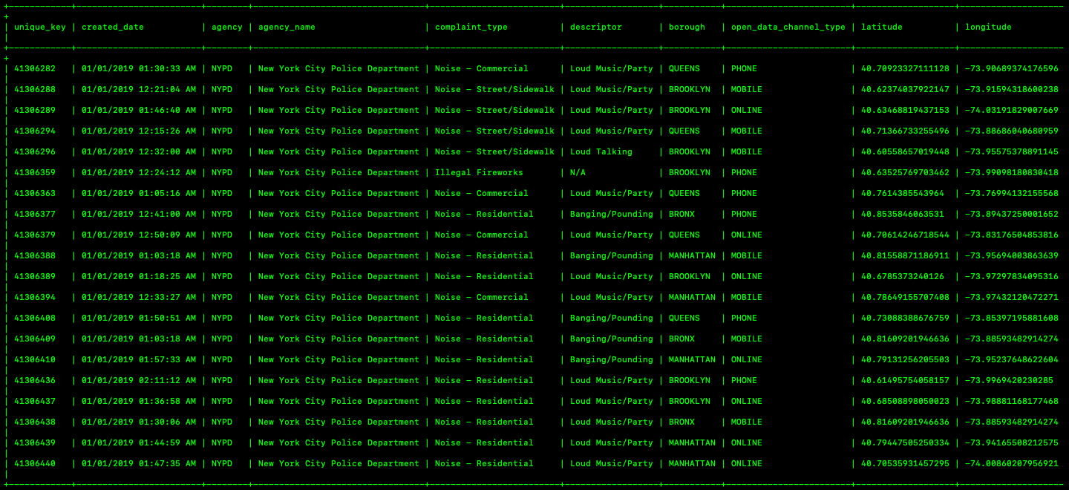
An Analysis of crime and complaints
Data Sample: 311 Service Requests for 2019

Slide 7
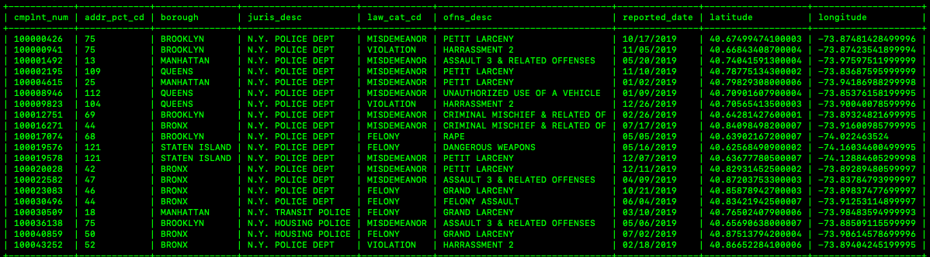
An Analysis of crime and complaints
Data Sample: NYPD Offenses Data Current (Year To Date)

Slide 8
An Analysis of crime and complaints
Design Diagram
311 Complaint Data
Cleaned 311 Data
Apache Impala
Final Analytic
Clean Data with Hadoop MapReduce
Join on Latitude and Longitude
NYPD Offenses Data
Cleaned NYPD Data

Slide 9
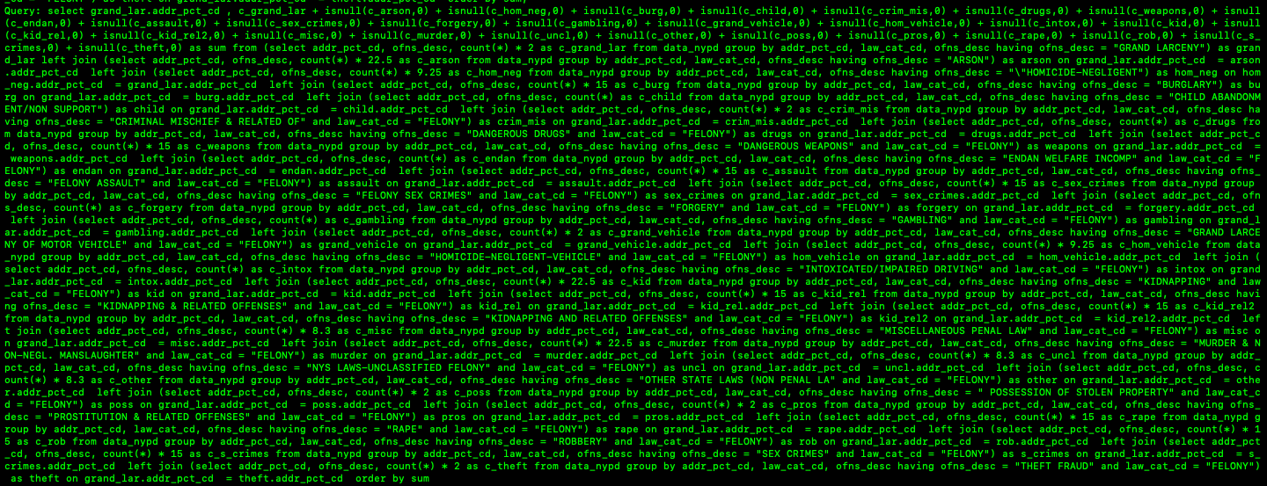
An Analysis of crime and complaints
Code Challenge 1

Slide 10
An Analysis of crime and complaints
Insights
1. As the level crime in a location increased, so did the number of 311 complaints.
2. Some 311 complaint types did not follow the above trend, with Blocked Driveways and Large Item Pickup occurring the most. This means that in high crime areas, residents are less likely to contact 311 in regards to city services in favor of resolving complaints like noise or graffiti.
3. Calling the 311 number was the most-used method to report complaints, though it declined as crime level increased in favor of online and text reporting.

Slide 11
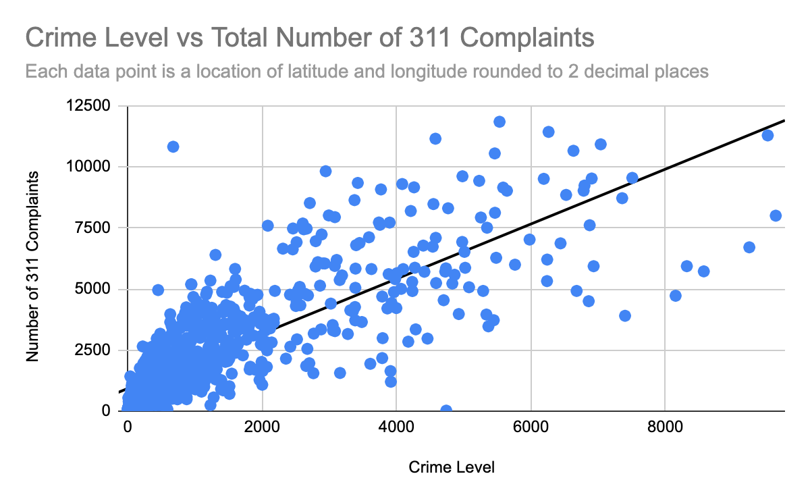
An Analysis of crime and complaints

Slide 12
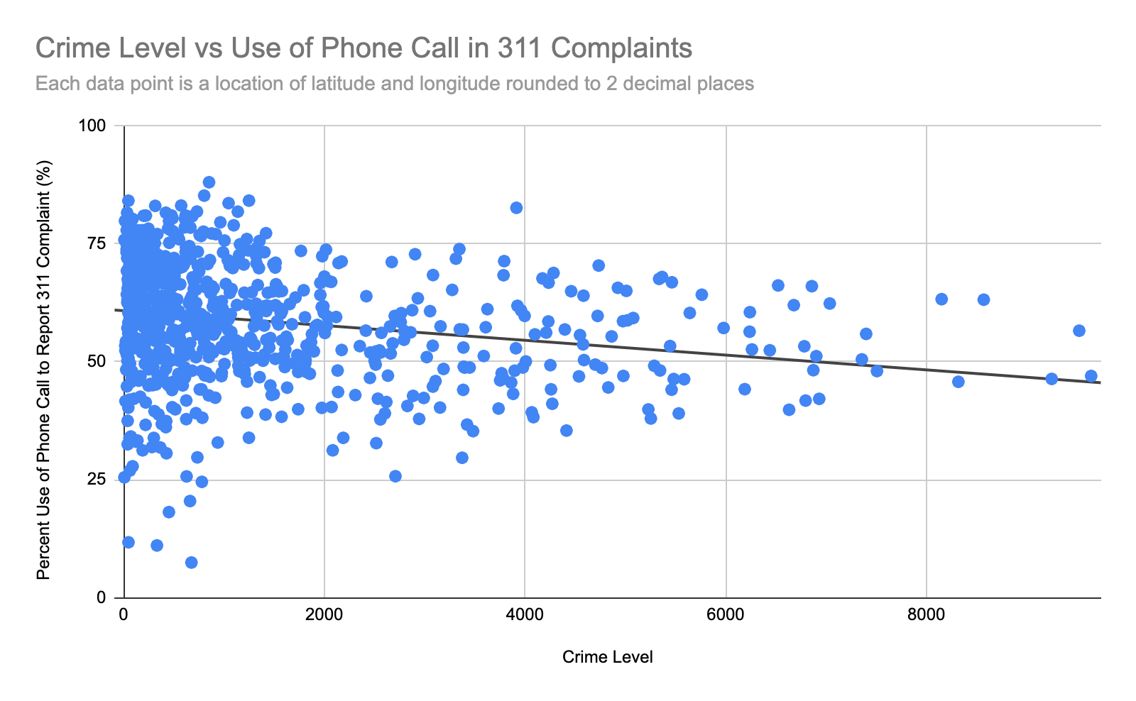
An Analysis of crime and complaints

Slide 13
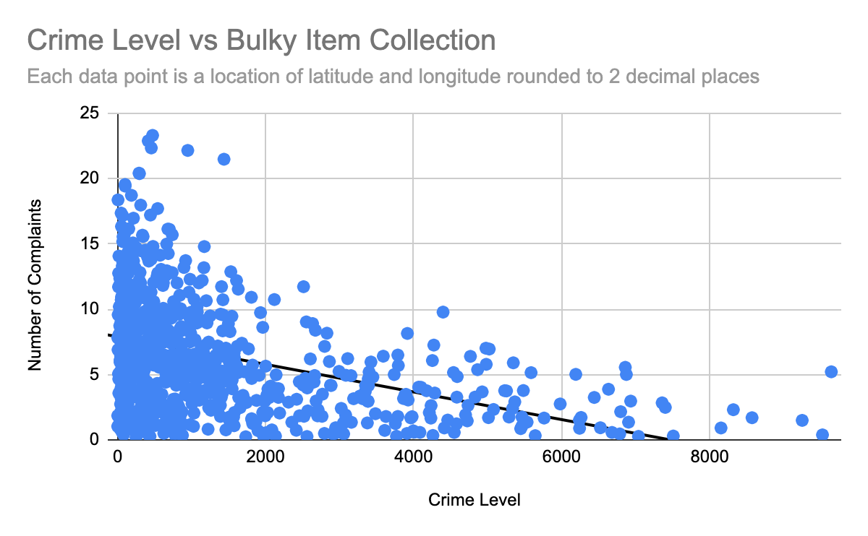
An Analysis of crime and complaints

Slide 14
An Analysis of crime and complaints
Obstacles
1. One of the obstacles that we encountered in the beginning was that in cleaning the data some of the fields had extra commas in them which made it hard to get the exact fields that we wanted.
2. Another obstacle that we encountered was coming up with a method to determine crime level in a location. Neither of us are domain experts, so we had to use different sources to come up with our own formula of multiplying prison sentences by number of crimes.
3. We also struggled in the beginning of the project as this topic was not what we had initially intended to analyze. We planned to use an API to get weather data that could be joined with data about COVID-19, but the site ended up not being free. Our COVID dataset was also rather skeletal and would have difficult to use alongside another.

Slide 15
An Analysis of crime and complaints
Summary:
In summary we found this project engaging and a good use of the material that we learned in this class. We were able to string together complex queries to find interesting results, particularly in regards to crime and quality of life in New York City.
Some future changes that could improve the project if it were repeated:
Working with a domain expert to get a more accurate way to determine crime level with the NYPD data.
The inclusion of a precinct field in the 311 data would have made joining the sets much easier.
Using latitude and longitude relied on rounding and is less tangible than a precinct or borough.
Further mathematical analysis of the data - neither of us have much of a background in statistics.

Slide 16
An Analysis of crime and complaints
Acknowledgements
Thank you Professor McIntosh! You helped us a lot through the project and it was a great experience to develop our own analytic.

Slide 17
An Analysis of crime and complaints
References
https://opendata.cityofnewyork.us/ - NYC Open Data, where we got both of our data sets.
http://ypdcrime.com/penal.law/offense_level.htm - The site whose numbers we used to determine the average prison sentences in New York State.
https://nypost.com/2019/01/23/nypd-announces-new-plan-to-combat-crime-in-dangerous-neighborhoods/ - One of the sources we used to make sure our determined “high crime” locations were accurate.

Slide 18
An Analysis of crime and complaints
Thank you!

